Slide 1
Phoodie: Restaurant Point of Sale System

Slide 2
The Team
Anthony Quigley (ajquigle@oakland.edu) - Computer Science
Jiann-Cherng (Mel) Chi (jchi@oakland.edu) - Computer Science
Mitchell Moore (mamoore4@oakland.edu) - Computer Science
Timothy Parzynski (tpparzyn@oakland.edu) - Information Technology

Slide 3
Roles
Mel - Development Engineer, Project Manager
Anthony - Development Engineer
Tim - Requirements Engineer
Mitch - Requirements and Development Engineer

Slide 4
Requirements
Previous:
Login
Register
Validate email
Reset Password
Tim Parzynski

Slide 5
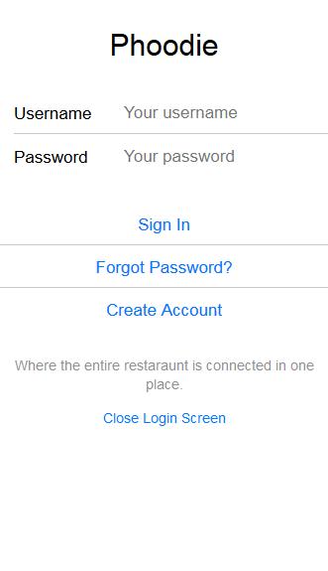
Tim Parzynski

Slide 6
Requirements
Current:
Kitchen Interface
Orders details
Changing order status
Admin Interface
Continued SRS Upkeep and Documentation
Tim Parzynski

Slide 7
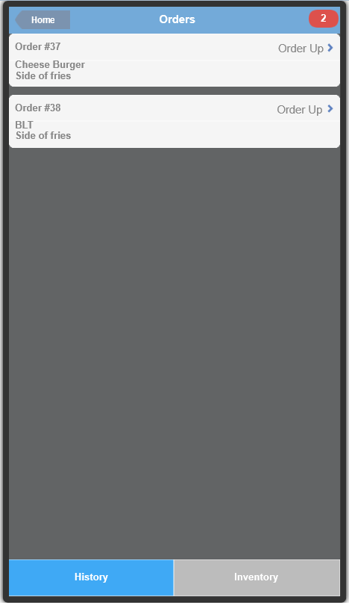
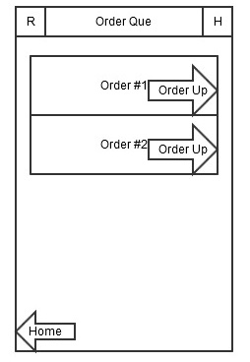
Final Prototype
Initial Mockup
Tim Parzynski

Slide 8
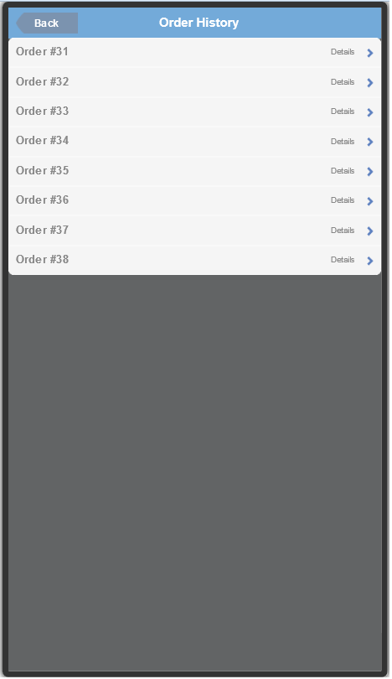
Tim Parzynski

Slide 9
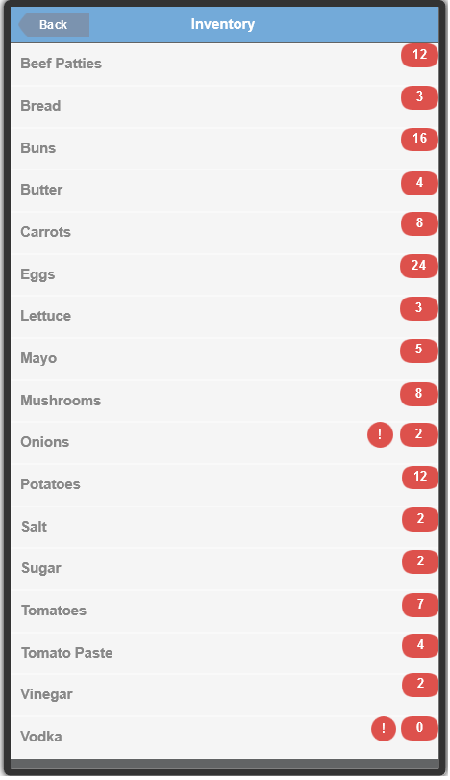
Requirements
Future Requirements :
Add Ingredients for Kitchen for inventory
Tim Parzynski

Slide 10
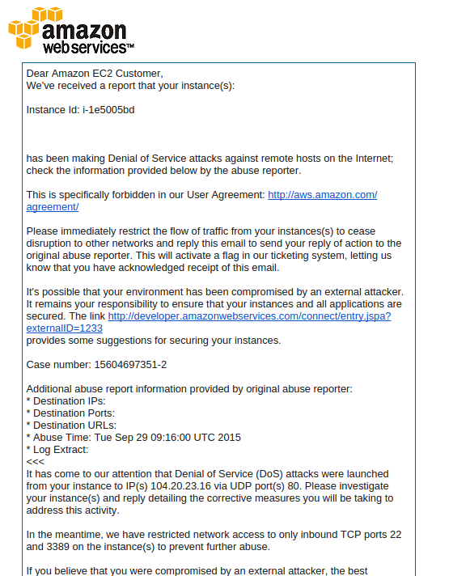
Development: DDOS Issue (EC2 Server)
Current:
EC2 Instance hijacked
Likely cause:
Tomcat applications deployed that weren’t ours
Using default username/password for WAR file deployment
Fix:
Terminate, recreate and reconfigure our EC2 server
Use uncommon tomcat manager login info
Anthony

Slide 11
Development: Servlets
Current:
Kitchen:
GetUnfinishedOrders
ItemStarted
Changes overall order state when applicable
ItemCooked
Changes overall order state when applicable
OrderStarted
OrderCooked
Admin:
AddRestaurantUser
GetRestaurantUsers
DeleteRestaurantUser
ChangeRestaurantUser
Major error checks:
Make sure you don’t delete or remove admin permissions from your own account
Make sure multiple kitchen workers don’t undermine work via out of sync interfaces
Anthony

Slide 12
Development: Front End
Current:
Kitchen Interface
Setting up Order Queue with order status update and order is ready functions
Admin Interface(Not Fully Functional)
Add User
Get list of Users
Delete User
Update User
Mitch

Slide 13
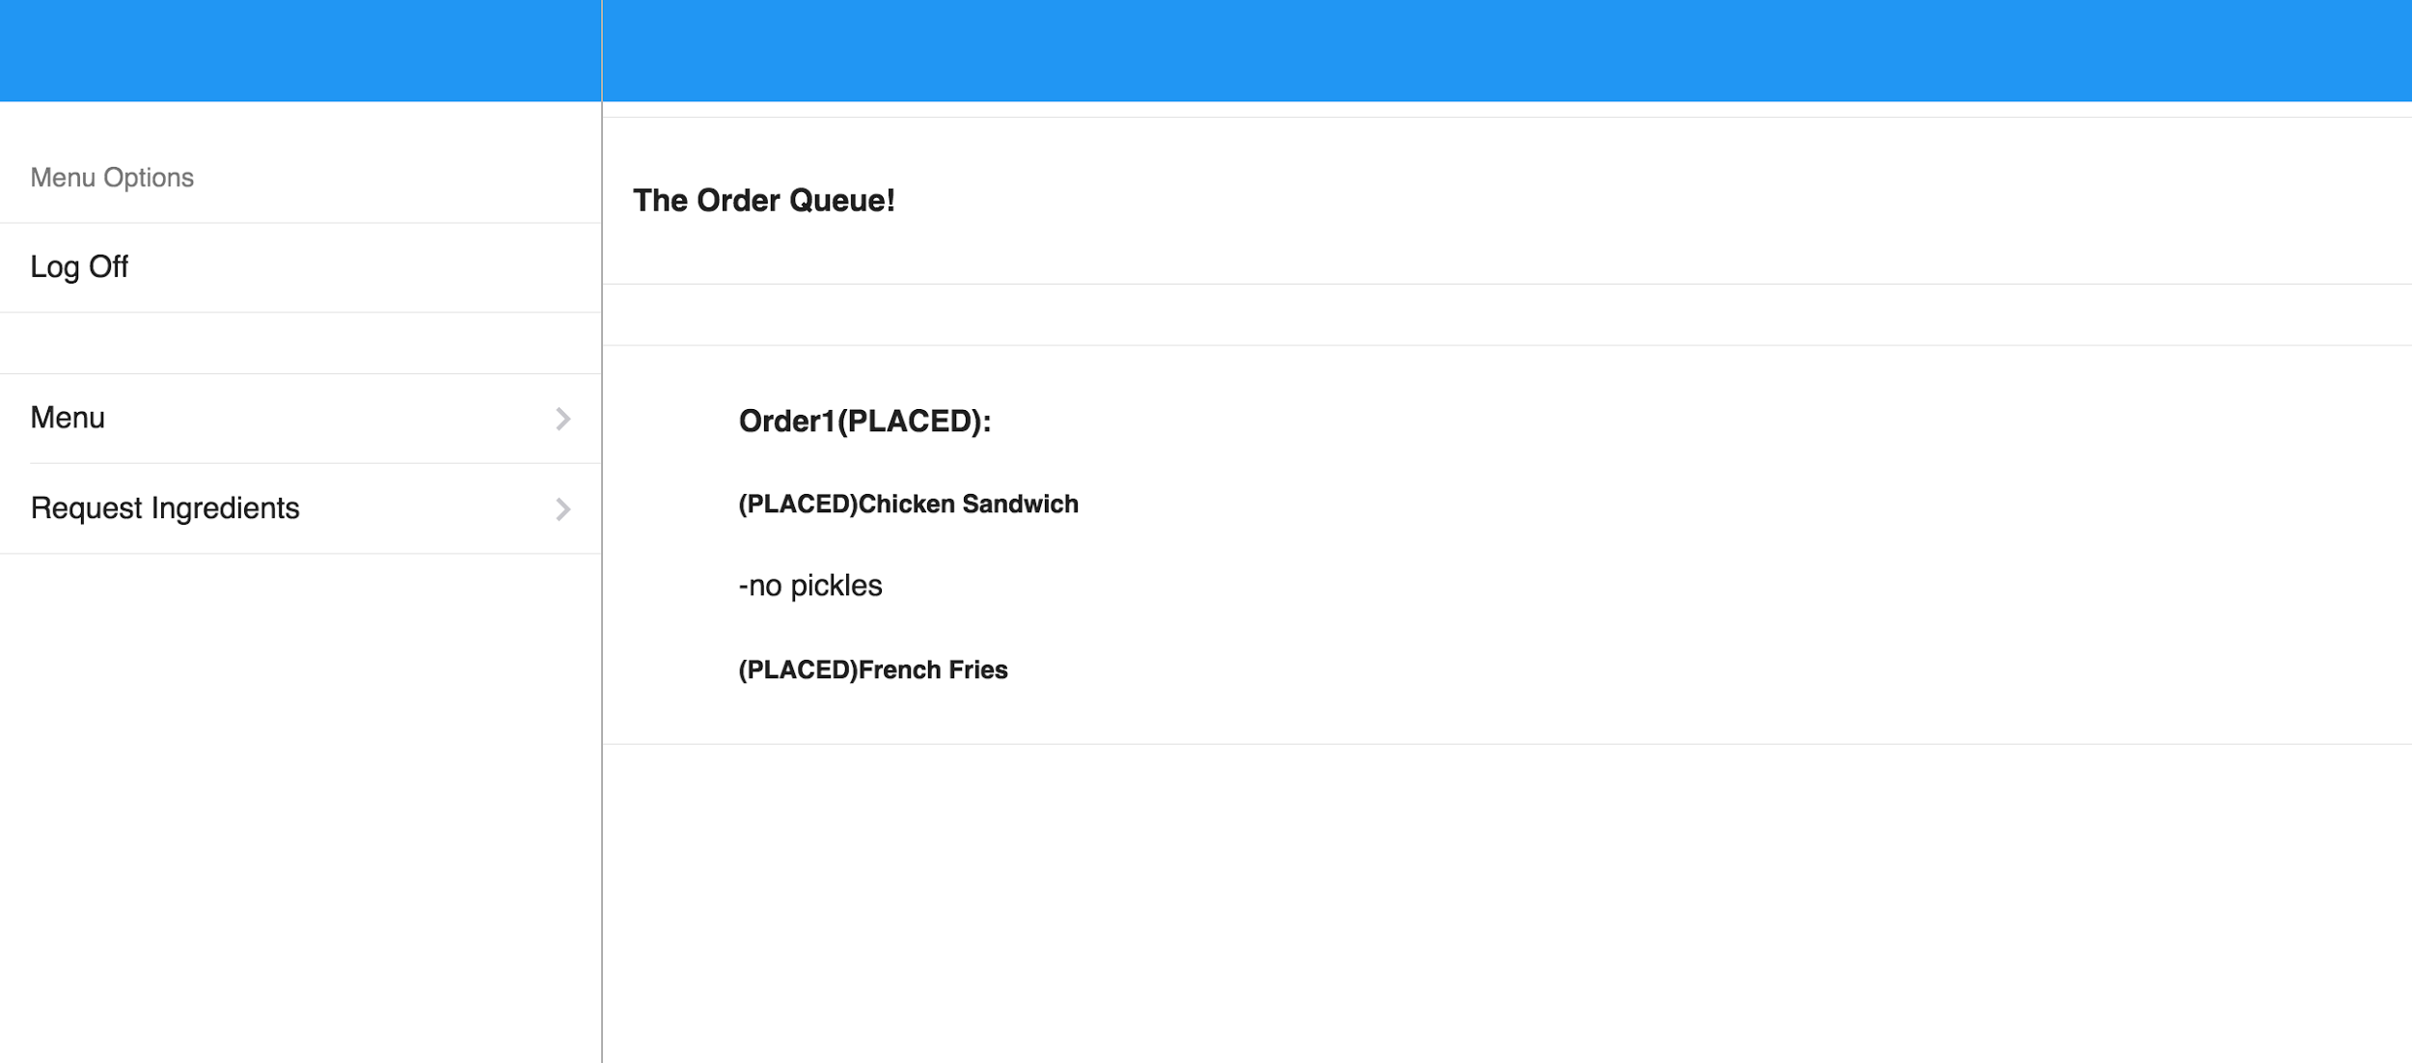
Kitchen Home Page
Mitch

Slide 14
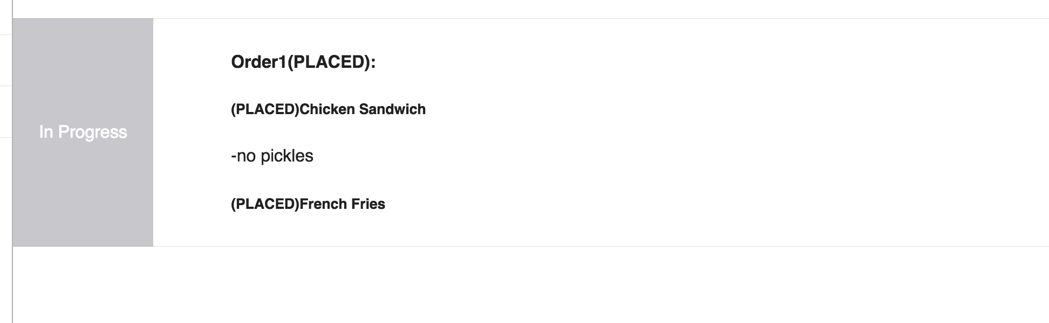
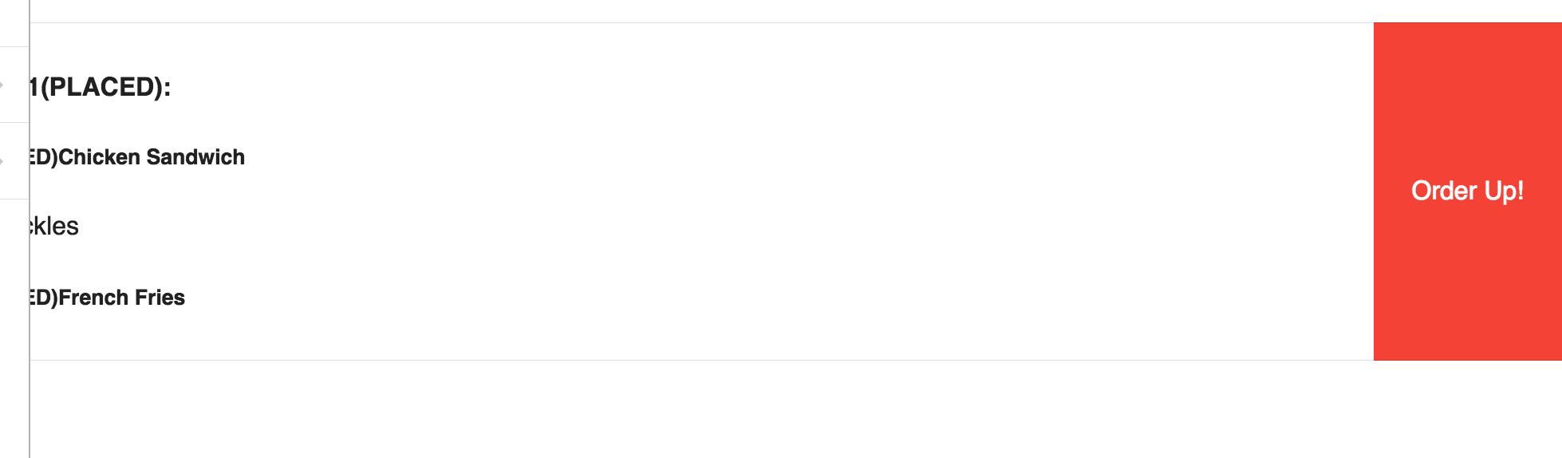
Edit Orders
Mitch

Slide 15
Development: Helper Classes
Current:
Created a String Manipulation Class to Help with the Front Side
Easy string manipulation when we return code
MySQL Utilities More Complex
Will add more as specific tasks come along
Still debating if it should be a static class
Error Checking:
JUNIT Tests
Mel

Slide 16
Development
Future:
Construct requirements for the Front of House
Created Servlets for Front of House
Create Interface for Front of House
Add More Security on our Servers
Start looking into custom templates for FOH to design table layouts*
Mel, Mitch, Anthony

Slide 17
QA
No QA This week.
This Week’s Plan
Kitchen Interface and Server Tests
Admin Interface and Server Tests

Slide 18
Project Management
Assigned Roles Last Thursday
Assigned work that day
DDOS Issue On Tuesday
Moved Table making to what each interface needs
MEL CHI

Slide 19
Schedule (previous)
Date | Iteration | Goals
10/1/2015 | 2 | Main Tables completed Host(ess)/Waiter(ress) Food Ordering Enhance MySQL Utilities
10/8/2015 | 3 | Kitchen Interface Finished
MEL CHI

Slide 20
Schedule (projected)
Date | Iteration | Goals
10/1/2015 | 2 | Kitchen Interface Finished Admin Interface Started MySQL Utilities and String Utilities Main Tables for Kitchen Interface Done
10/8/2015 | 3 | Host(ess)/Waiter(ress) Food Ordering More Security on Server Convert Old Servlets to use Utilities Main Tables for FOH Interface
10/15/2015 | 4 | Security improvements, QA, Sleeker UI
MEL CHI

Slide 21
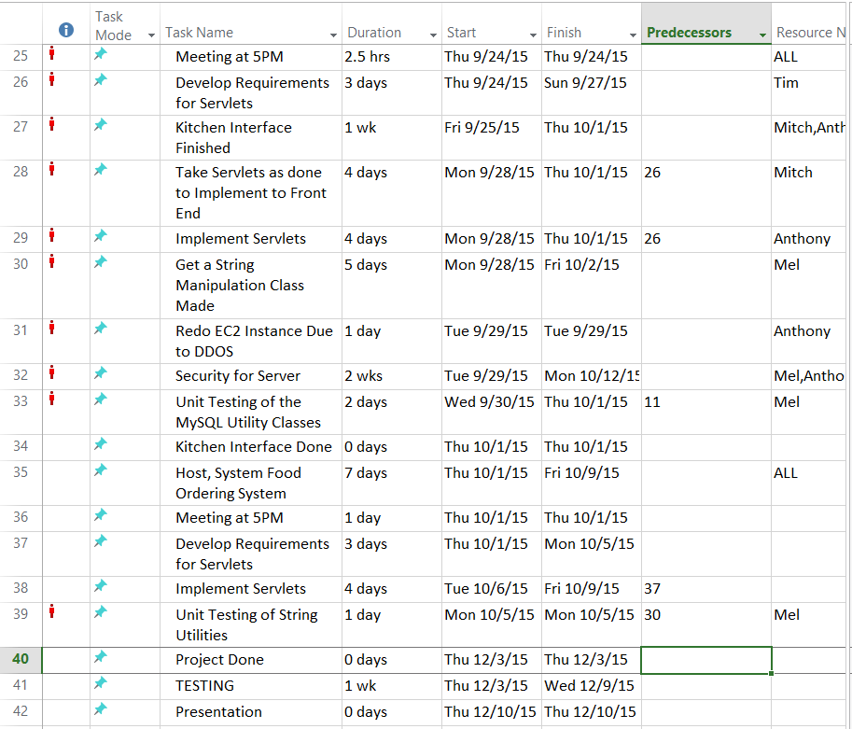
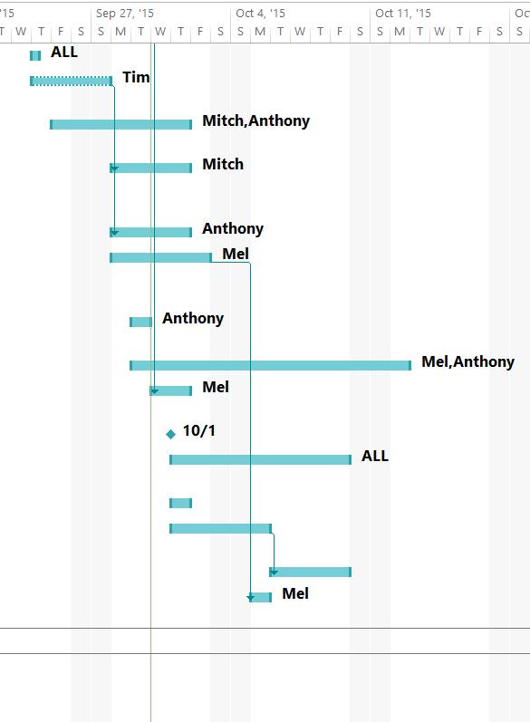
MEL CHI

Slide 22
This Week
Host(ess)/Waiter(ress) Food Ordering
More Security on Server
Convert Old Servlets to use Utilities
Main Tables for FOH Interface
Start making stuff more pretty.
MEL CHI

